Slide 1
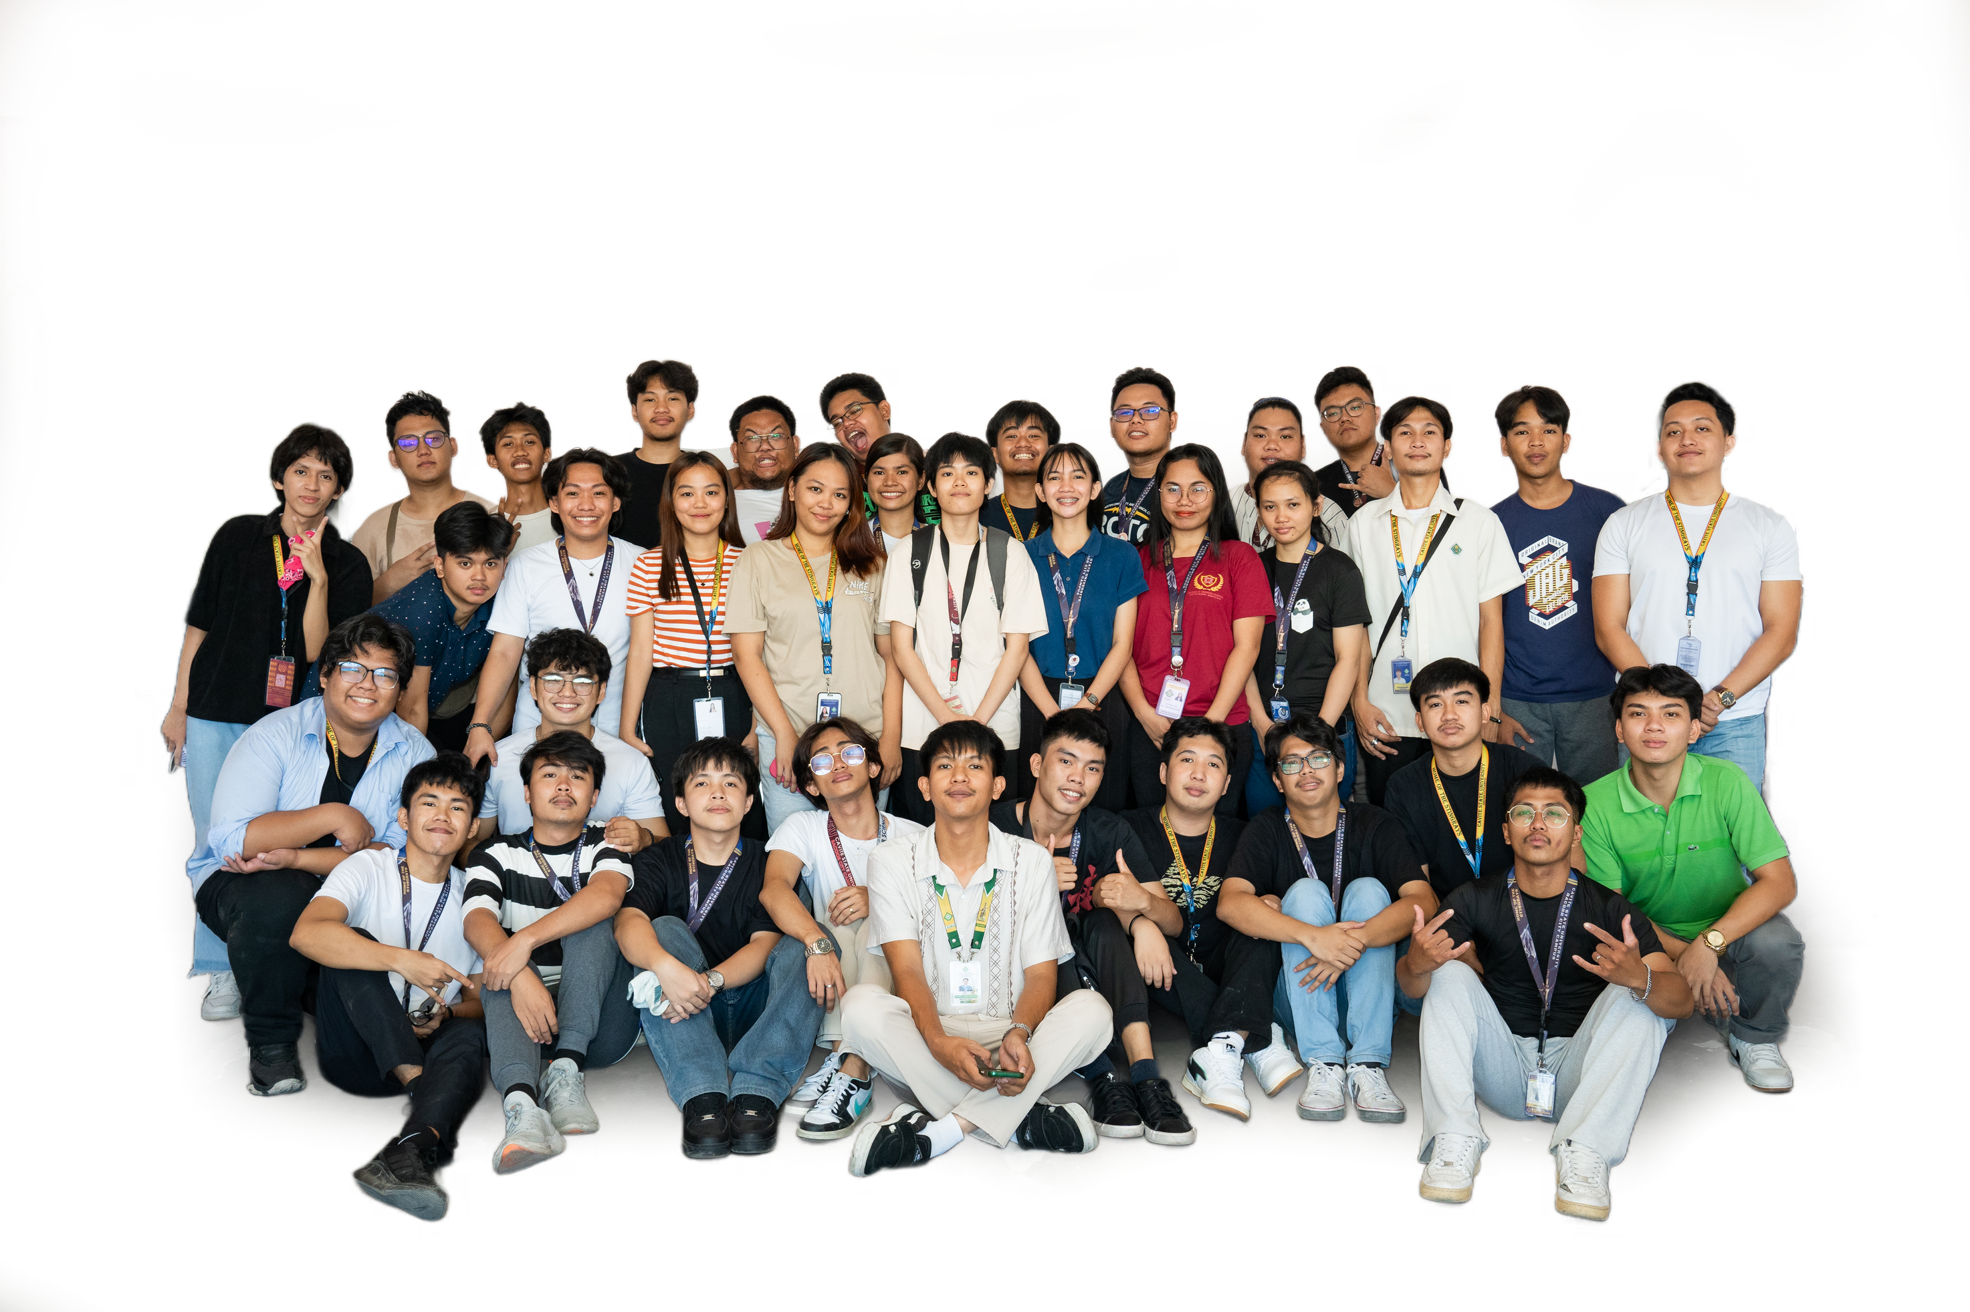
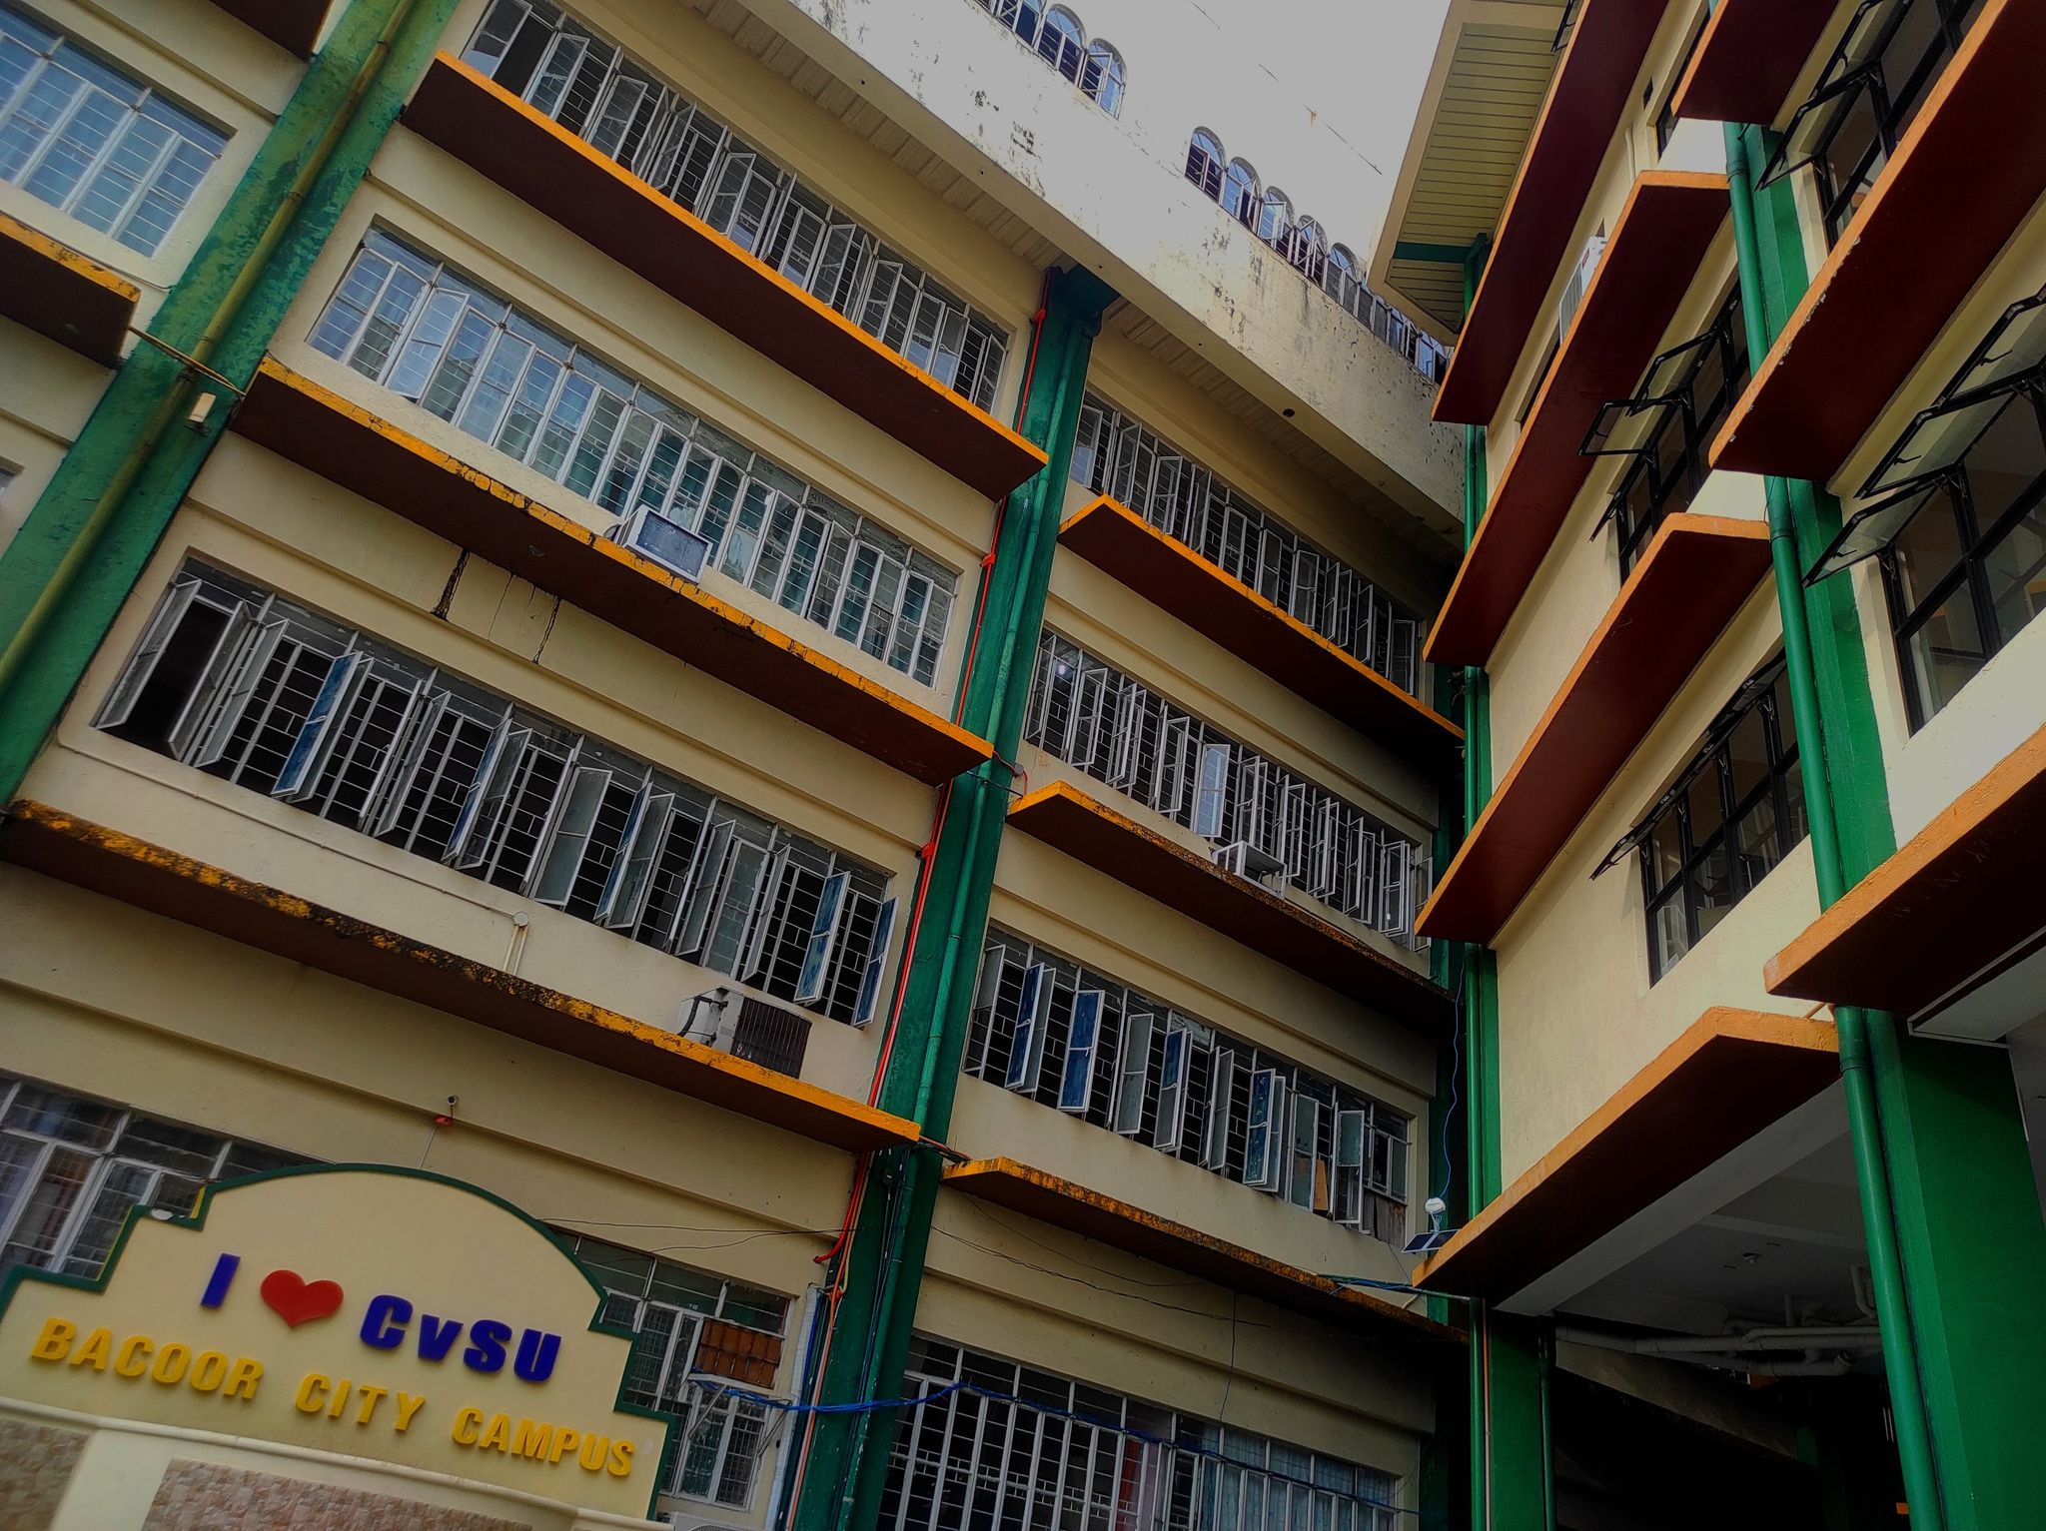


CAVITE STATE UNIVERSITY
BSCS 2-3
Rufino Dela Cruz
Bacoor Campus
SY 2023 - 2024

Slide 2
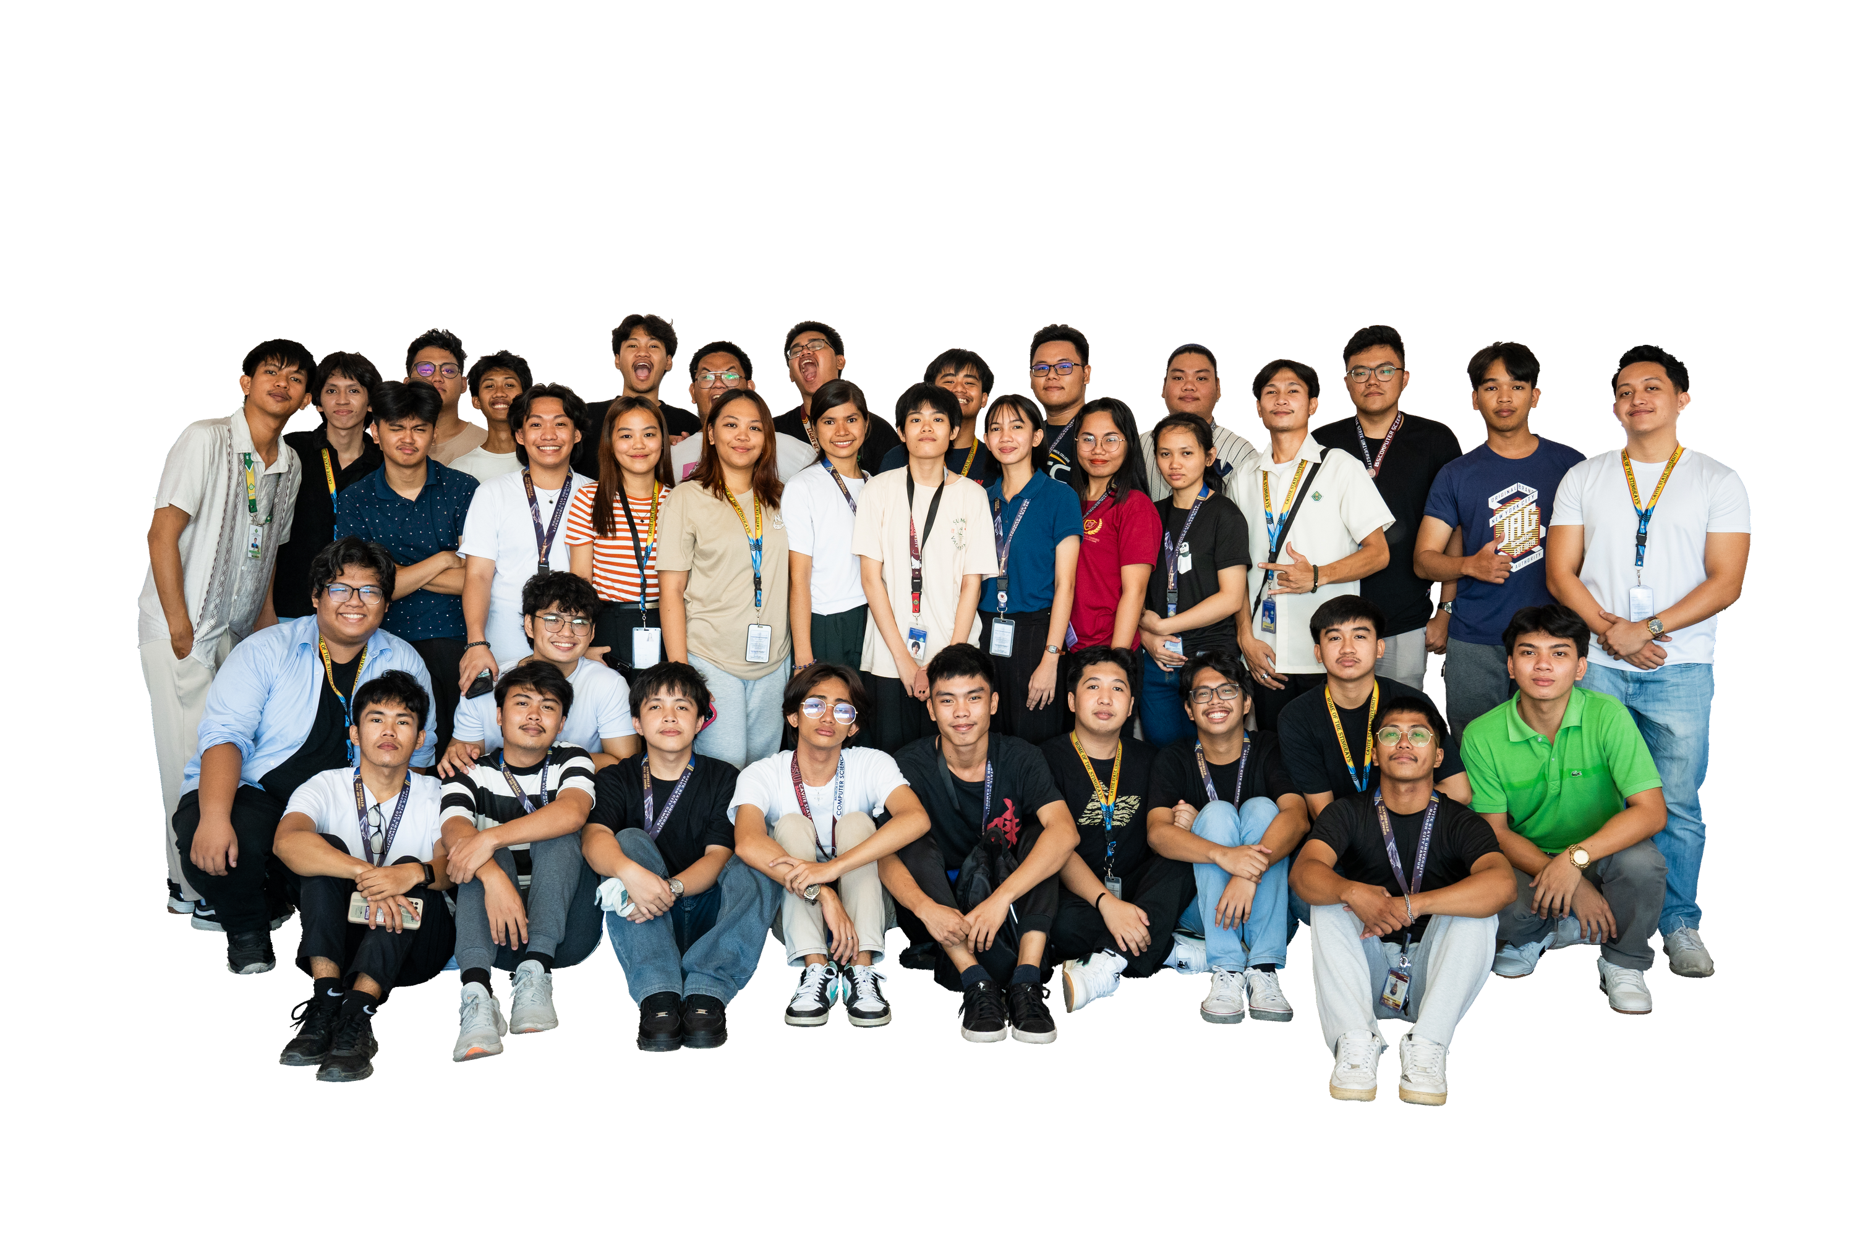
CAVITE STATE UNIVERSITY
BSCS 2-3
Rufino Dela Cruz
Bacoor Campus
SY 2023 - 2024

